Slide 1
Sıralama Algoritmaları-II

Slide 2
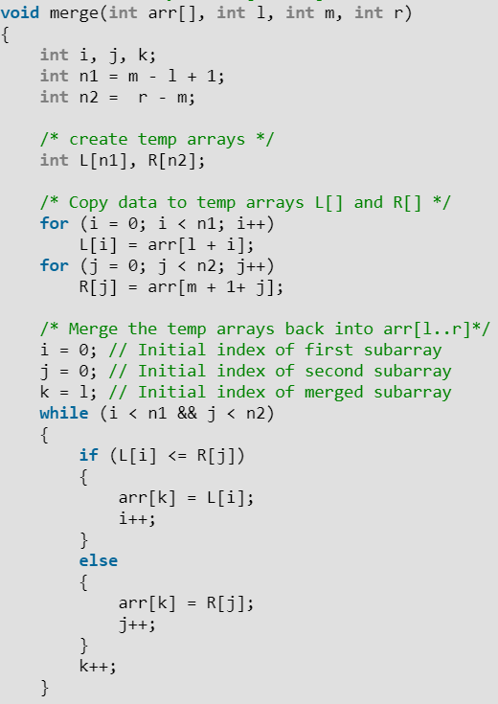
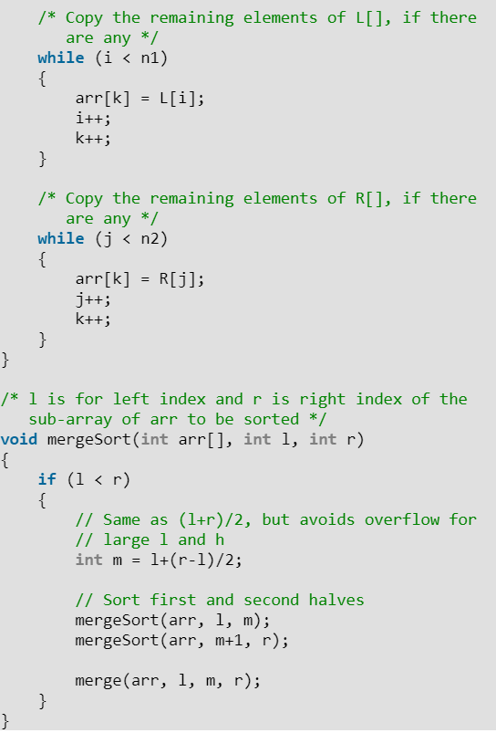
Merge

Slide 3
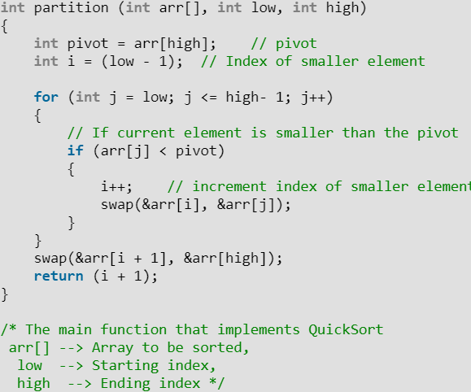
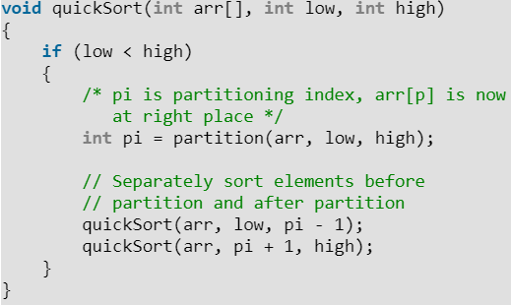
Quick Sort

Slide 4
Kaynaklar
http://bilgisayarkavramlari.sadievrenseker.com/2008/08/09/siralama-algoritmalari-sorting-algorithms/
https://www.geeksforgeeks.org/bubble-sort/
https://www.cs.usfca.edu/~galles/visualization/ComparisonSort.html

